Slide 1
Building
European Spallation Source
– a multi-disciplinary research centre and the world’s most powerful neutron source!
Agneta Nestenborg
Director of Project Support & Administration
European Spallation Source ERIC
2018-07-05

Slide 2
Vision and mission statement
Core values
Excellence
Openness
Collaboration
Sustainability
Vision Our vision is to build and operate the world’s most powerful neutron source, enabling scientific breakthroughs in research related to materials, energy, health, and the environment, and addressing some of the most important societal challenges of our time
Mission To do this, we commit to deliver ESS as a facility that: Is built safely, on time and on budget Produces research outputs that are best-in-class both in terms of scientific quality and in terms of socioeconomic impact Supports and develops its user community, fosters a scientific culture of excellence and acts as an international scientific hub Operates safely, efficiently, and economically and responds to the needs of its stakeholders, its host states and member states Develops innovative ways of working, new technologies, and upgrades to capabilities needed to remain at the cutting edge

Slide 3
A true green field project – Project Funding
Total project cost 1.843 B€₂₀₁₃
Host Countries Sweden and Denmark
Construction 47.5% Cash Investment ~ 97%
Operations 15%
Non Host Member Countries
Construction 52.5% In-kind Deliverables ~ 70%
Operations 85%
Members’ initial aspiration for In-kind: 670 M€ !
Notes:
Hur möjliggör man finansiering från Europa?

Slide 4
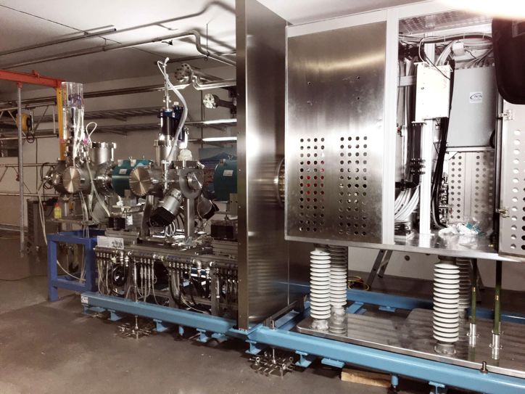
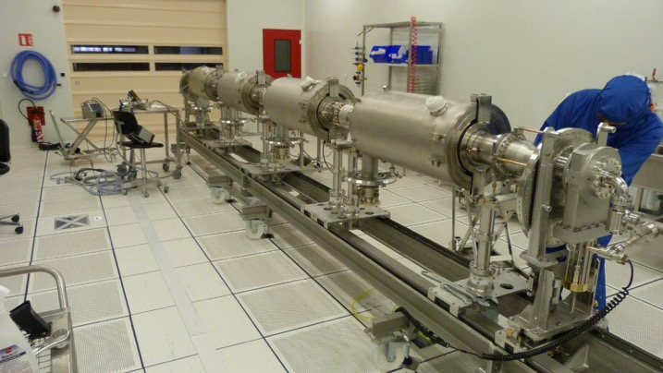
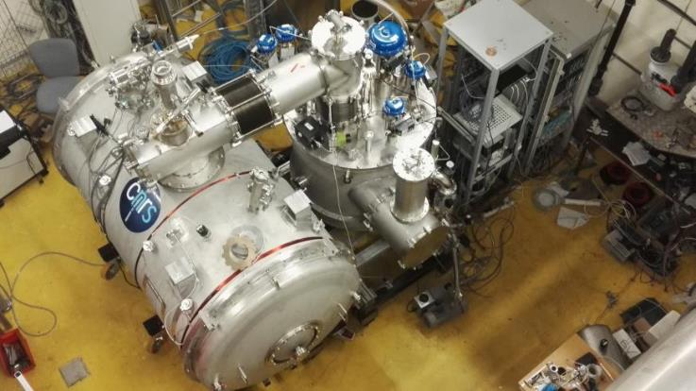
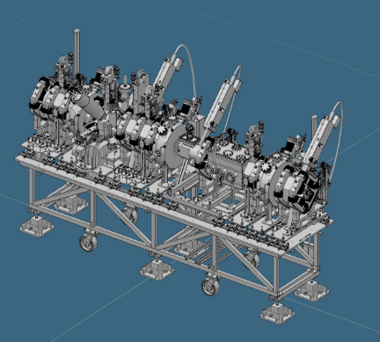
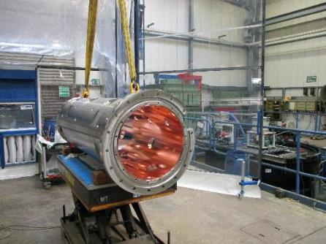
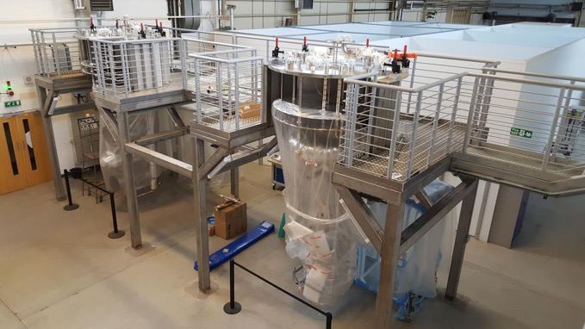
Partners
Aarhus University
Atomki - Institute for Nuclear Research
Bergen University
CEA Saclay, Paris
Centre for Energy Research, Budapest
Centre for Nuclear Research, Poland, (NCBJ)
CNR, Rome
CNRS Orsay, Paris
Cockcroft Institute, Daresbury
Elettra – Sincrotrone Trieste
ESS Bilbao
Forschungszentrum Jülich
Helmholtz-Zentrum Geesthacht
Huddersfield University
IFJ PAN, Krakow
INFN, Catania
INFN, Legnaro
INFN, Milan
Institute for Energy Research (IFE)
Rutherford-Appleton
Laboratory, Oxford(ISIS)
Kopenhagen University
Laboratoire Léon Brilouin (CEA – CNRS – LLB)
Lund University
Nuclear Physics Institute of the ASCR
Oslo University
Paul Scherrer Institute (PSI)
Polska Grupa Energetyczna - PGE
Roskilde University
Tallinn Technical University
Technical University of Denmark
Technical University Munich
Science and Technology Facilities Council
UKAEA Culham
University of Tartu
Uppsala University
WIGNER Research Centre for Physics
Wroclaw University of Technology
Warsaw University of Technology
Zurich University of Applied Sciences (ZHAW)

Slide 5
Previous VAT workshop
Previous VAT workshop held 14-15 June 2016
Objective to understand the status of VAT treatment for
a) ERIC
b) the Representing Entities and
c) the In-Kind partners.
Exchange experiences in respective Member countries.
Identify key common issues relative to VAT treatment and Partners.

Slide 6
How Does the VAT Work with the ERIC?

Slide 7
VAT in Partners’ member states
PRECONDITION
APPROACHES
OUTCOMES
Local tax authority exemption
Representing entity acting in the name of member
Representing entity using 15(10) forms
IKC Allocation
ESS ERIC recognized as an International Organisation
yes
yes
VAT Exemption / Reimbursement
no
yes
no
yes
no
yes
no
no
NO solution
(pay VAT)

Slide 8
Ways forward were established
VAT status in Member countries:
Country | VAT Status
France | 15(10) Certificate
Hungary | Exempt
Italy | Trilateral In Kind Contribution Agreement (Elettra, INFN, ESS)
Spain | Exempt
Switzerland | Non-EU/ Awaiting Confirmation
United Kingdom | 15(10) Certificate
ESS estimated a cost exposure of between €25-50 million IF THE ISSUE WAS NOT resolved with all partners;
Member country VAT status varies, but solutions have been found.
Some solutions require a more active approach by ESS.
The VAT question now shifts with the project – towards installations in Sweden
Notes:
Country level VAT has been discussed for some time, and this purely relates to the VAT that you – the in kind partner – gets charged in your own countries locally.
A lot of time and effort has been put to solve some of these cases and some solutions have been found, e.g. 15/10 in France and UK, Hungary and Spain seem to enjoy an exemption; Switzerland is a non EU country, though we await further confirmation about this.
Clearly the ESS project is shifting towards goods and services being delivered to the site here in Lund Sweden, and this shift means that we need to start focusing on potential VAT risks in Sweden.

Slide 9
VAT risks in Sweden
Topic addressed at AFC in November 2017
AFC requested in April 2018 a dedicated workshop for in kind partners to consider VAT risks in Sweden
ESS and legal tax advisors prepared a “Guideline on possible VAT risks in Sweden for in kind partners”
Notes:
Some pointers for the bullets:
- You will hear today from KPMG more about what considerations need to be taken into account when we refer to VAT risks in Sweden.
As mentioned, country level VAT has been discussed for some time, however due to the ESS project shifting towards e.g. installations taking place here in Sweden, it is understood that there is a VAT risk for in kind partners and/or their suppliers due to this fact.
Both the country level VAT as well as VAT risks in Sweden have been highlighted to governance forums for some time now, including AFC where these topics were presented November 2017 and again in April 2018.
Which brings us to today – 5th July – and this workshop where ESS aims to:
Try to provide guidance for In Kind Partners on the issue of VAT risks in Sweden. I must emphasize that solutions might not be possible to achieve today for all the different transactions you will be involved in, however hopefully you will appreciate the way in which you will need to consider your transactions.
ESS worked with KPMG tax advisors on a guideline identifying the most common types of VAT “transactions” that could affect in kind partners and/or their sub-contractors. It must be emphasized that the VAT Directive and VAT law generally is very complex. From a non-exhaustive list of over 70 potential VAT “transactions”, we were able to narrow down this list to approximately 5 which are most likely to affect In Kind Partners and/or their sub-contractors. But this is not to say that these are the only 5 types of VAT “transactions” which will happen, the 5 types of VAT “transactions” act as an indicator for potential transaction scenarios that the In Kind Partners should consider.
The guideline is now prepared and we will go through it today with all of you - In Kind Partners – since you are best placed to assess your own tax exposure and seek advice from independent experts since you will be in the best position to assess the types of “transactions” you will perform in Sweden and also because you have the contractual relationship with your suppliers and sub-contractors with whom you might need to discuss these issues directly. Due to the complexities of VAT legislation, combined with the complex deliveries from In Kind Partners to ESS, ESS – at the request of the AFC in April 2018 - is convening this workshop to In Kind Partners to raise awareness of the issues at hand.

Slide 10
Vision and mission statement
Vision Our vision is to build and operate the world’s most powerful neutron source, enabling scientific breakthroughs in research related to materials, energy, health, and the environment, and addressing some of the most important societal challenges of our time
Mission To do this, we commit to deliver ESS as a facility that: Is built safely, on time and on budget Produces research outputs that are best-in-class both in terms of scientific quality and in terms of socioeconomic impact Supports and develops its user community, fosters a scientific culture of excellence and acts as an international scientific hub Operates safely, efficiently, and economically and responds to the needs of its stakeholders, its host states and member states Develops innovative ways of working, new technologies, and upgrades to capabilities needed to remain at the cutting edge
Core values
Excellence
Openness
Collaboration
Sustainability

